Slide 1
Wave initiation in neural columns (v2)
Vincent Baker
Drexel University Department of Physics

Slide 2
Plan
Last time we compared the isolated traveling waves from bottom stimulus to the waves that result from stimulating the entire column. Noticed there might be a negative correlation.
Plan of attack:
Explicitly determine correlation between the wave density of single waves and the wave initiation sites during whole-column stimulus
Perform a statistically significant experiment to examine correlation
Result: We see a negative correlation between single wave density and wave initiation sites
Also plotted wave speed against delay parameter and connectivity parameter

Slide 3
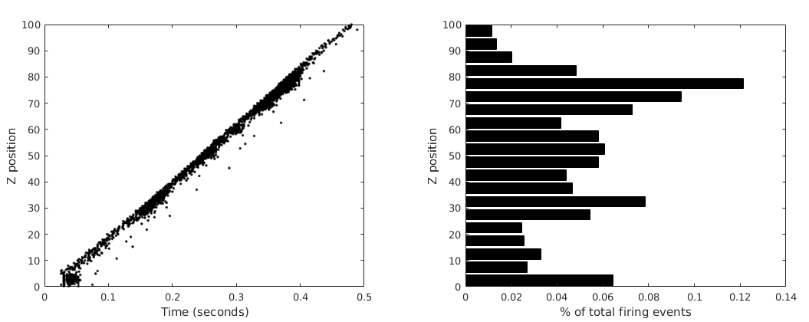
Wave density
Stimulate bottom 5 layers of a 100 layer column at t=10 ms
Consistent and repeatable single waves
Histogram of firing events to identify possible preferential firing regions

Slide 4
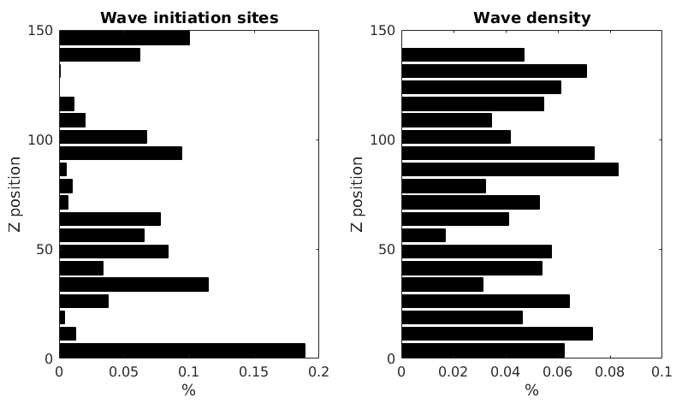
Correlation between density and initiation sites
Simulated a single column 100 times with both impulsive and background stimulation
Created composite histogram of wave initiation sites for 100 background stimulations
Created composite histogram of firing density for 100 impulsive simulations
Calculated correlation coefficient between the histograms, excluding first bin (site of impulsive stimulation)
Correlation coefficient -0.45

Slide 5
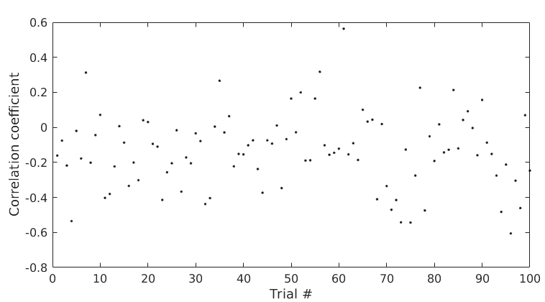
Correlation experiment
Repeated previous experiment for 100 randomly generated columns
Consistent negative correlation (mean -0.13, std 0.21), but the degree of correlation definitely depends on the individual column structure

Slide 6
Wave speed
Calculated average wave speed (units/sec) for combinations of delay parameter κ and connectivity parameter λ
For inter-neuron distance d:
Connection probability – exp(-(d/ λ)^2)
Propagation delay – κd
Simulated 10 columns for every κ-λ combination, impulsive stimulus at bottom of column to create a single traveling wave

Slide 7
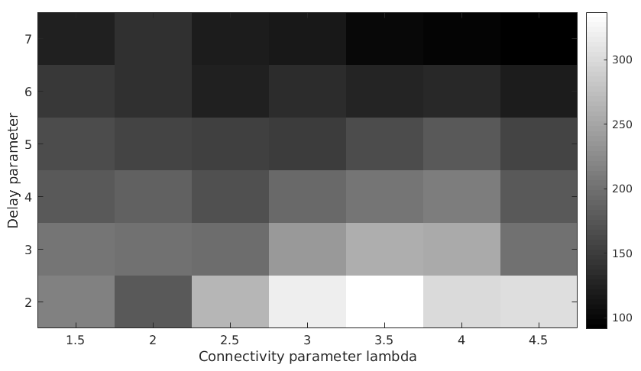
Wave speed
For inter-neuron distance d:
Connection probability exp(-(d/ λ)^2)
Propagation delay κd
Wave speed decreases with increasing κ
Seems to be a region of higher speed around λ=3:3.5, need to investigate
Wave speed (units/sec)
Add parameter letters

Slide 8
Notes
Possibly excise or modify regions/neurons to understand density/initiation correlation

